Slide 1

DSTL Funding
Case Study Presentation
MSc Data Analytics Yu Hong Wong Jitprpap Mekusa Danaya Lorpattanakasem Zhang Shuang Xueyuan Wang
GROUP
2
Submission to - Carly Porrett , Systems Thinking and Consulting Group

Slide 2
Outline
Aims: Cost optimisation through data science
Focus:
Personnel
Equipment Maintenance
Health and Training Performance

Slide 3
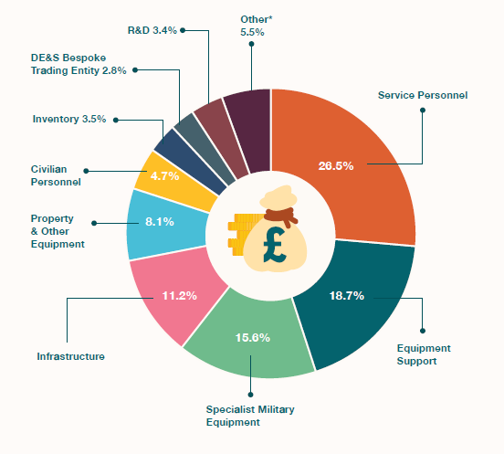
Introduction
UK military budget in 2017/18: ~ ￡36.6 billion
Service Personnel + Equipment Support + Specialist Military Equipment > 50%
Method: Predictive Analytics by Machine Learning
More specifically,
Task Allocation
Workforce planning and allocation
Personnel Training Program
etc.
Figure 1: Defence Expenditure in 2017/18 (Ministry of Defence, 2018)

Slide 4
Personnel
Task Assignment:
Analytics to find out the common characteristics of a person that affect the performance
-e.g. background / qualification / skills
Workforce Optimisation
Predict the number and characteristics needed for different tasks based on a predictive model
-e.g. what was the job / type of job / … (project details)
→Better task assignment and recruitment
→Efficiency and performance
→Less redundant task and less recruitment
→less personnel needed (e.g. HR)
→Job satisfaction

Slide 5
Equipment Maintenance
Sensor Technology & Internet of Things:
Monitoring equipment performance and conditions with machine learning, which analyses and predict any abnormality and performance gaps and their patterns
-Vibration / cracks (able to detect something could hardly be seen)
-e.g. Vibration sensor, fault sensor, corrosive damaged sensor, and crack detection sensor.
→More precise prediction and monitoring
→Condition-based maintenance
→Avoid failure of the whole system
→Lower maintenance cost on equipment
→Optimise purchasing plan & the subsequent cost (e.g. storage)
→Detailed knowledge of equipment
→Higher performance

Slide 6
Health and Training Performance
Sensor Technology:
Monitoring training and health performance with machine learning, which analyses and predict any abnormality and performance gaps and their patterns
-Movement / running speed / heart rate / blood pressure / ground contact
-e.g. Wearable sensors (similar to Apple Watch).
→Precise assessment of soldiers’ training performance
→Optimal and personalised training programme
→Reduce risk of operation failure
→Optimise training and deployment cost
→Higher performance

Slide 7
Conclusion
Personnel: Long term saving
Biggest proportion of the budget
Seems to be difficult to decrease costs in short term
Cost optimisation and efficiency in long term
Equipment Maintenance: Most promising
It yields a more direct saving
Big part in the budget
Health and Training Performance: Quick win
Implement this does not much of preparing and planning time as the wearable sensors are available in the consumer market at cheap cost
Gathering data and applying data analytics tools does not take long

Slide 8
Reference
Ministry of Defence. (2018). UK Defence in Numbers. North Wales: Ministry of Defence UK.

Slide 9
Thank You

